Slide 1
Difference between C and C++

Slide 2
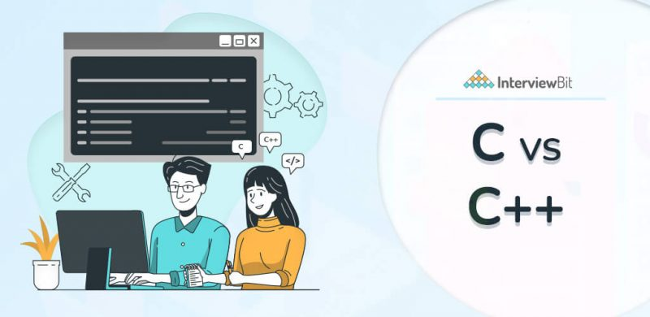
Difference between C and C++

Slide 3
Both of the programming languages, C and C++ have been used for diverse development purposes like game development, database system software, operating systems, GUI-based applications, and so much more. The two of them have so much to offer the programmers, so how can we pick one over the other?
Well, we will be first looking at the core of what is C and C++ followed by a tabular representation of detailed head-to-head comparison. Let’s get started!
Table Of Contents
show
sked
QWhat is C? Key Features of C
What is C++?
Key Features Of C++
Difference between C and C++
C vs C++: Which is better?
C Advantages
C Disadvantages
C++ Advantages
C++ Disadvantages
Conclusion
Frequently Auestions
Additional Resources

Slide 4
What is C?
C is a general-purpose, structured programming language that was introduced for system development work i.e., programs that make up the operating systems. It soon gained popularity for several application developments because of its flexibility, faster execution, and simplicity.
It was developed in the year 1972 by computer scientist Dennis Ritchie at the Bell Laboratories. C is known by the name of God’s programming language, as it forms the base of many of the modern-day languages you might have been studying today like Python, Java, C++, and many more.
The prevalence and versatility of C can be highlighted through the most popular applications and software built with this language. From working on different operating systems like Windows, Apple OS X, Symbian to mobile and desktop operating systems; From Language compilers, Network Drivers to one of the most known applications like MYSQL, Adobe, etc.

Slide 5
Key Features of C
C and C++, as we have read above, have their complexities, purposes, goals, and advantages. And before jumping on the comparison of C vs C++, we should read about the features for both of them as well.
Simple: C programming language is one of the oldest programming languages and is known for its simplicity and easy-to-understand format.
It forms the base for many programming languages and therefore, many programmers prefer C as a good starting point for beginners.
Portable: The C programming language is adaptable to different platforms and systems. This means that if you have written your code on one platform, you can port or run it on different platforms as well for modifications or updates. This is why C is called the machine-independent language.
Procedural Language: The C programming language uses a particular flow of the program to run the code. It breaks the code into the small blocks for differential functioning and minimizes the complexities.

Slide 6
Case Sensitive: The C programming language is case sensitive and will treat ‘C’ and ‘c’ as different variables.
Dynamic Memory Allocation: C supports dynamic memory allocation. It means C allows memory space during the run time as well. It plays to the advantage of the programmer because they cannot know beforehand the space or memory required while running the code.
Rich Library: To provide programmers with a better and simple coding experience, C gives them a library with built-in functions or user-defined functions. C has a rich library that caters to varied needs and requirements.
Speed: C programming is not only simple and efficient. It is also faster. In comparison to programming languages like Java and Python, C provides a rapid performance as it is a compiler-based language.

Slide 7
C++ or C with Classes is a general-purpose object-oriented programming language that is used to create high-performing applications. C++ was earlier known by the name of C with classes as it was an amalgamation of C and Simula67 (first object-oriented language). It means that with the properties of the C programming language, C++ also introduced the concepts of classes and objects for user-defined data types.
The origin of C++ goes back to 1979, developed by Bjarne Stroustrup. The idea behind C++ was, as the name suggests, to bring about a general-purpose language that should not be limited to a specific use. It is used with Operating systems, high-end libraries, cloud distributed systems, compilers, game development, smartwatches, graphic applications and so much more

Slide 8
Today, C++ is not just an extension to the C programming language, but, with 3 modern updates and high-end performance, makes it is one of the popular and in-demand programming languages. Top-tier companies like Amazon, Facebook, Google, and so many more rely on the advantages of C++.
C++ forms the base for programmers to learn about object-oriented programming in a simpler and thorough manner.

Slide 9
Key Features Of C++
Static Type System: A C++ is a compiler-based language. It means that before executing or running the code, we need to use a compiler that makes it understandable to the computer.
Fast and Powerful: As C++ is a compiler-based language, it enhances and makes the execution of the code faster. Plus, with an extensive assortment of functions and data types, etc, it makes the language powerful and a sure choice for programmers.
Pointers: A point in the C++ language holds the address of a particular object. It is a feature that allows programmers to use pointers for interacting with the functions, arrays, memory and structures with less code and rapidly.

Slide 10
Object-Oriented Language: The language C++ was an extension to the procedural programming language C, and as such included the OOP (object-oriented programming) concepts.
C++ based on OOP concepts means that it organizes development design around data and objects rather than the functions or logic that acts upon them. Objects have attributes and methods associated with them. For example, “type of programming languages” is a type of class (blueprint for an object), Python, C++, C are different objects and features, advantages, etc are the properties (data) of the object. So, the OOP concepts bind the data and functions together.
The concepts which OOP includes are Polymorphism, Encapsulation, Abstraction, Inheritance, etc that helps with code maintenance, prevent data redundancy, ensure flexibility and effective problem solving and so much more.
Extensible: C++ programming language is known for its extensibility because it is flexible in adapting to new features and any modifications in design.
Additional Features: It is to be noted that since C++ is a superset of the programming language C, it includes all the features of C as well, like dynamic memory allocation, rich library, structured programming, portability, etc.

